Slide 1

NEWS AGGREGATOR
SAIMANOJ KUMAR KANKANALA
AKSHAY VADALA
FARAZ SHAIK
CHANDAN AVIRENI
N.SATHWIK

Slide 2
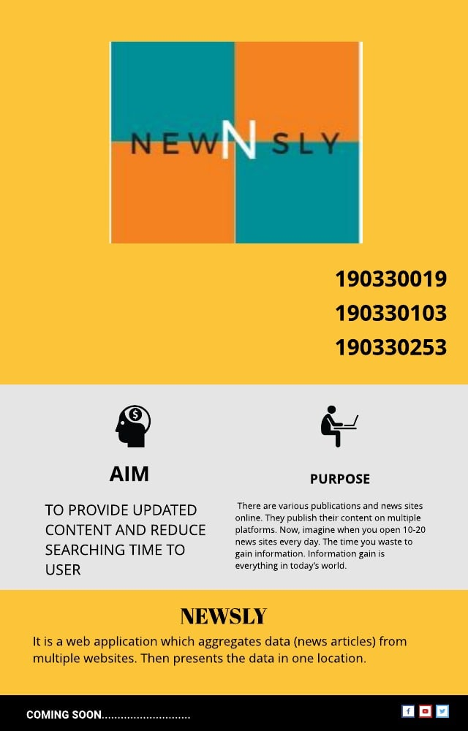
190330303 190330159

Slide 3
AGENDA
1. About
2.Introduction
3. Objectives
4.Scope
5.Concept
6.Libraries
7. Design
8. System requirements: 9.Hardware and Software
10.Conclusion

Slide 4

WHAT IS NEWS AGGREGATOR
It is a web application which aggregates data (news articles) from multiple websites. Then presents the data in one location.
News aggregator service is a very important start of the day.
There are various publications and news sites online. They publish their content on multiple platforms. Now, imagine when you open 10-20 news sites every day. The time you waste to gain information. Information gain is everything in today’s world.

Slide 5
INTRODUCTION
AIM: TO PROVIDE UPDATED CONTENT AND REDUCE
SEARCHING TIME TO USER
PURPOSE OF THE SYSTEM
A news aggregator makes this task easier. In a news aggregator, you can select the websites you want to follow. Then the news aggregator collects the articles for you. And, you are just a click away to get information from various websites.

Slide 6
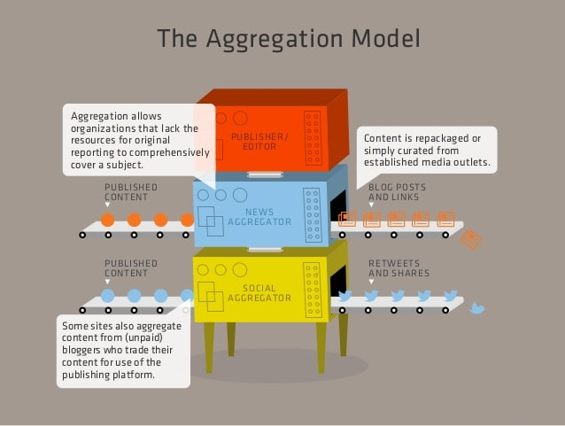

Slide 7
Objectives
In computing, a news aggregator, also termed a feed aggregator, feed reader, news reader, RSS reader or simply an aggregator, is client software or a web application that aggregates syndicated web content such as online newspapers, blogs, podcasts, and video blogs (vlogs) in one location for easy viewing.

Slide 8
SCOPE
The News Aggregator envisions a system that can automatically tell where a piece of content (i.e. object) on the Web comes from and who is responsible for that content after it has aggregated content. Content aggregation is widely used on the web.

Slide 9
Concepts
A news aggregator is a combination of web crawlers and web applications. Both of these technologies have their implementation in Python. That makes it easier for us.
So, our news aggregator will work in 3 steps:
It scrapes the web for the articles. ( we are scraping a related websites)
Then it stores the article’s images, links, and title.
The stored objects in the database are served to the client. The client gets information in a nice template.
So, that’s how our web app will work.

Slide 10
Libraries
To scrape the website, we will use beautifulsoup and requests module. These libraries are the bs4 and requests and modules are used for web crawling.

Slide 11
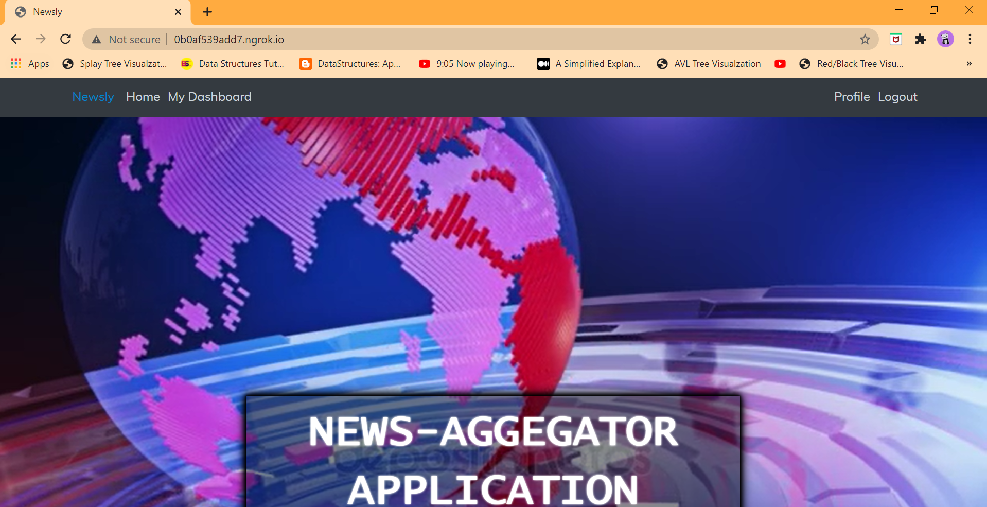

Slide 12
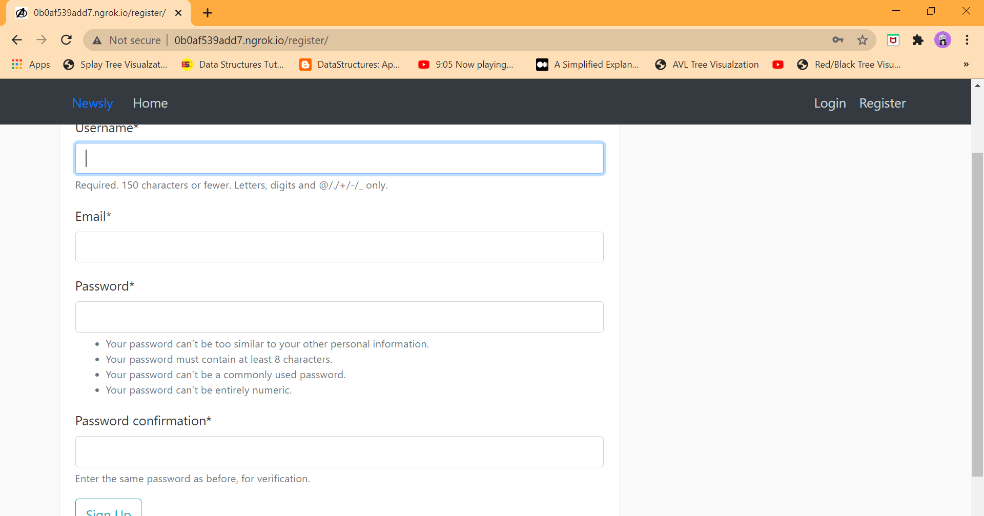

Slide 13
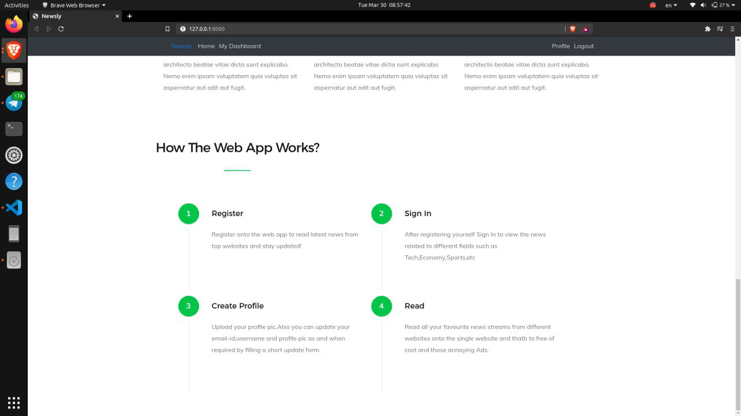

Slide 14
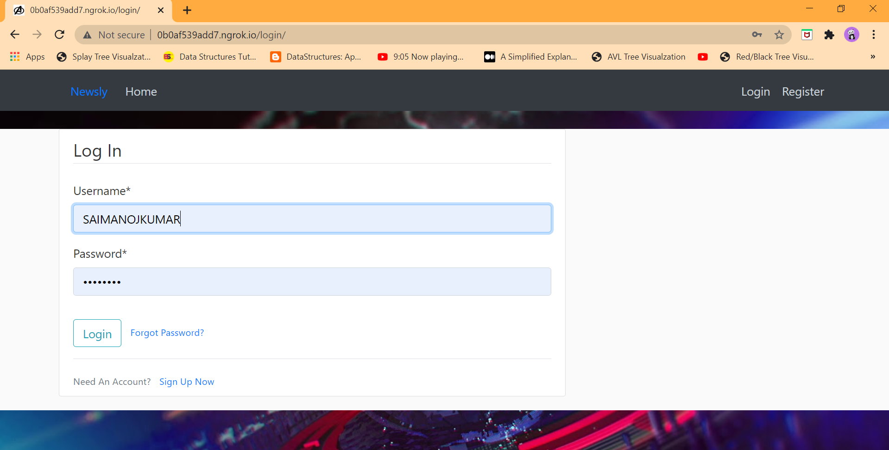

Slide 15
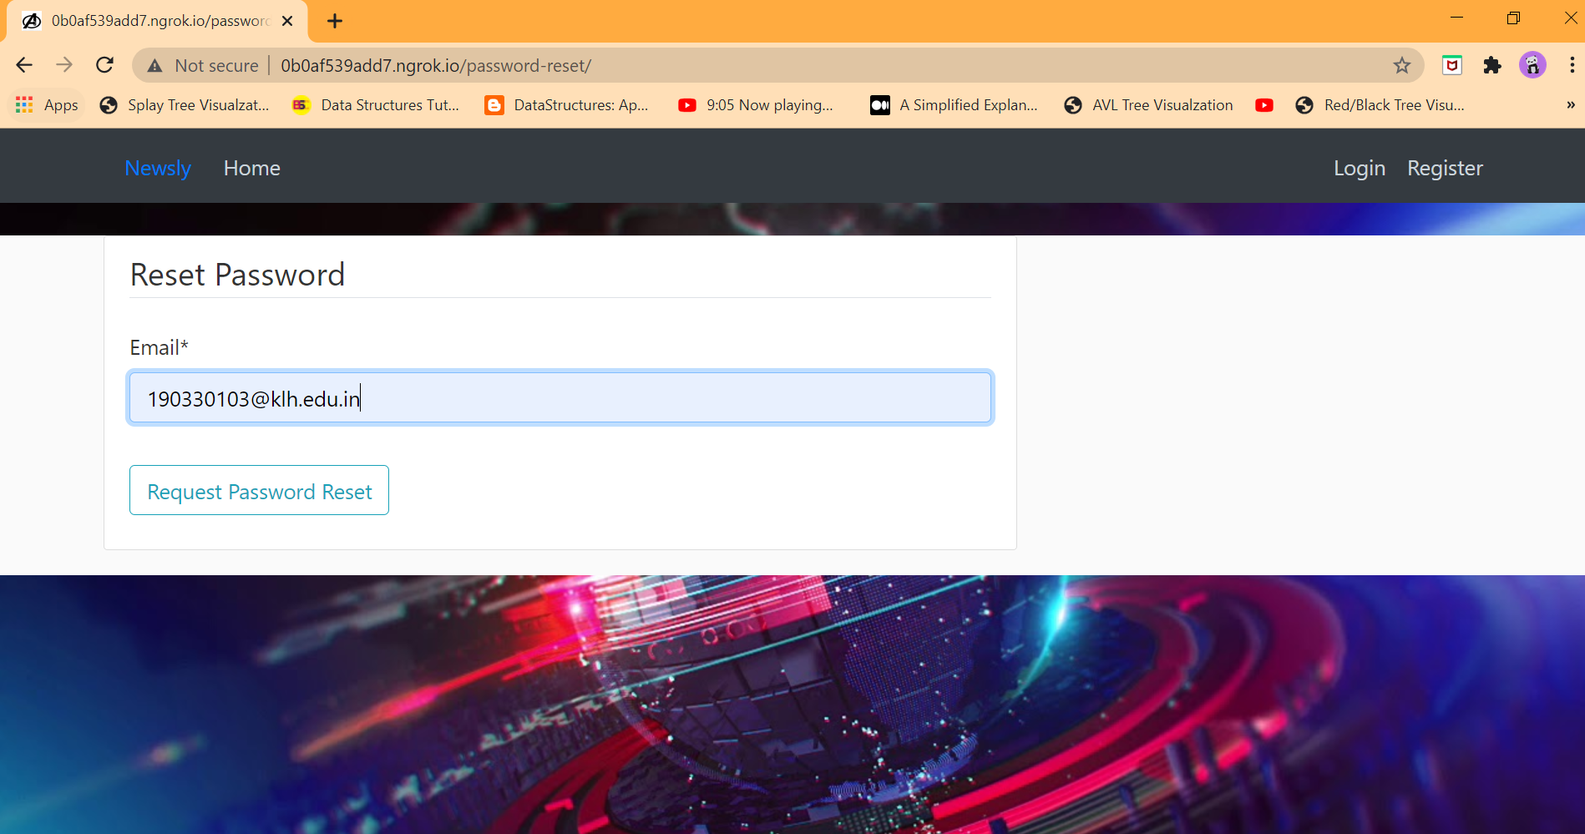

Slide 16
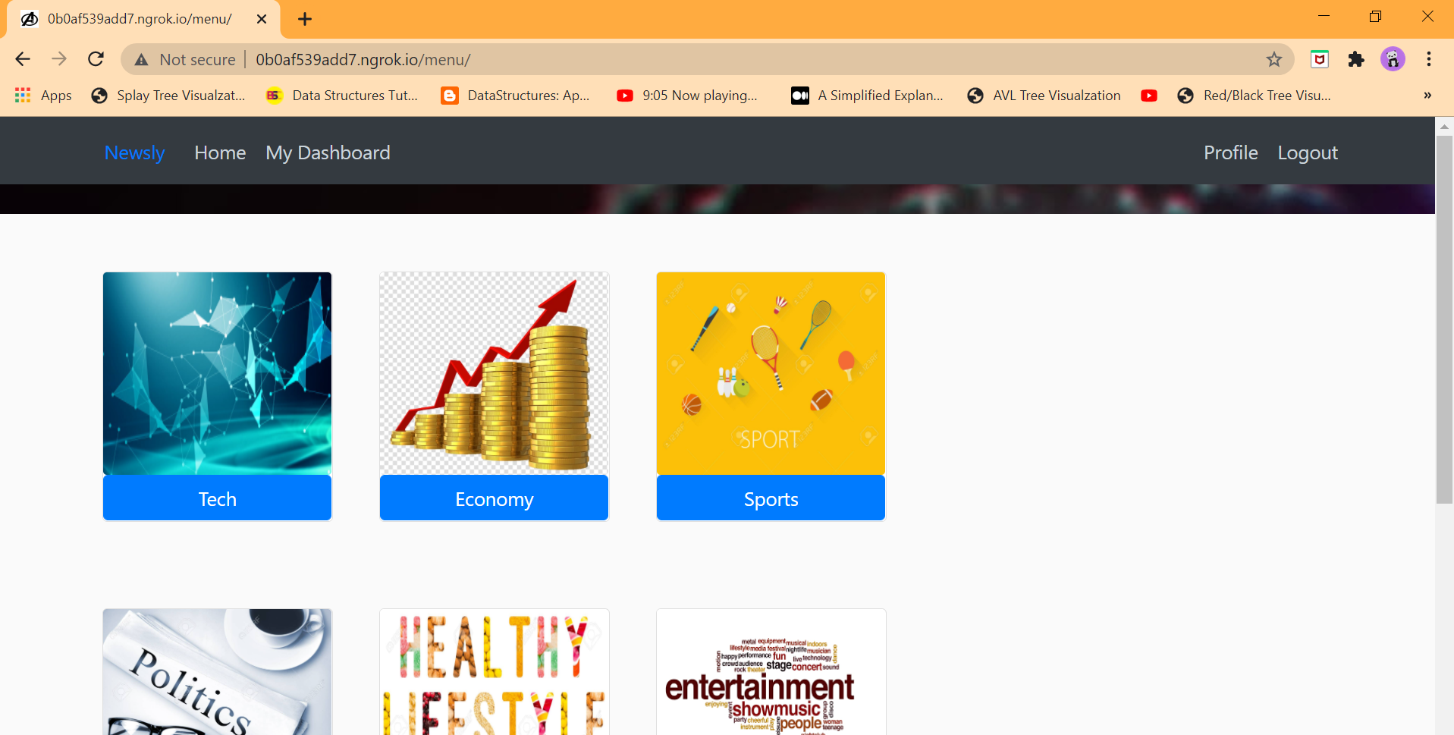

Slide 17
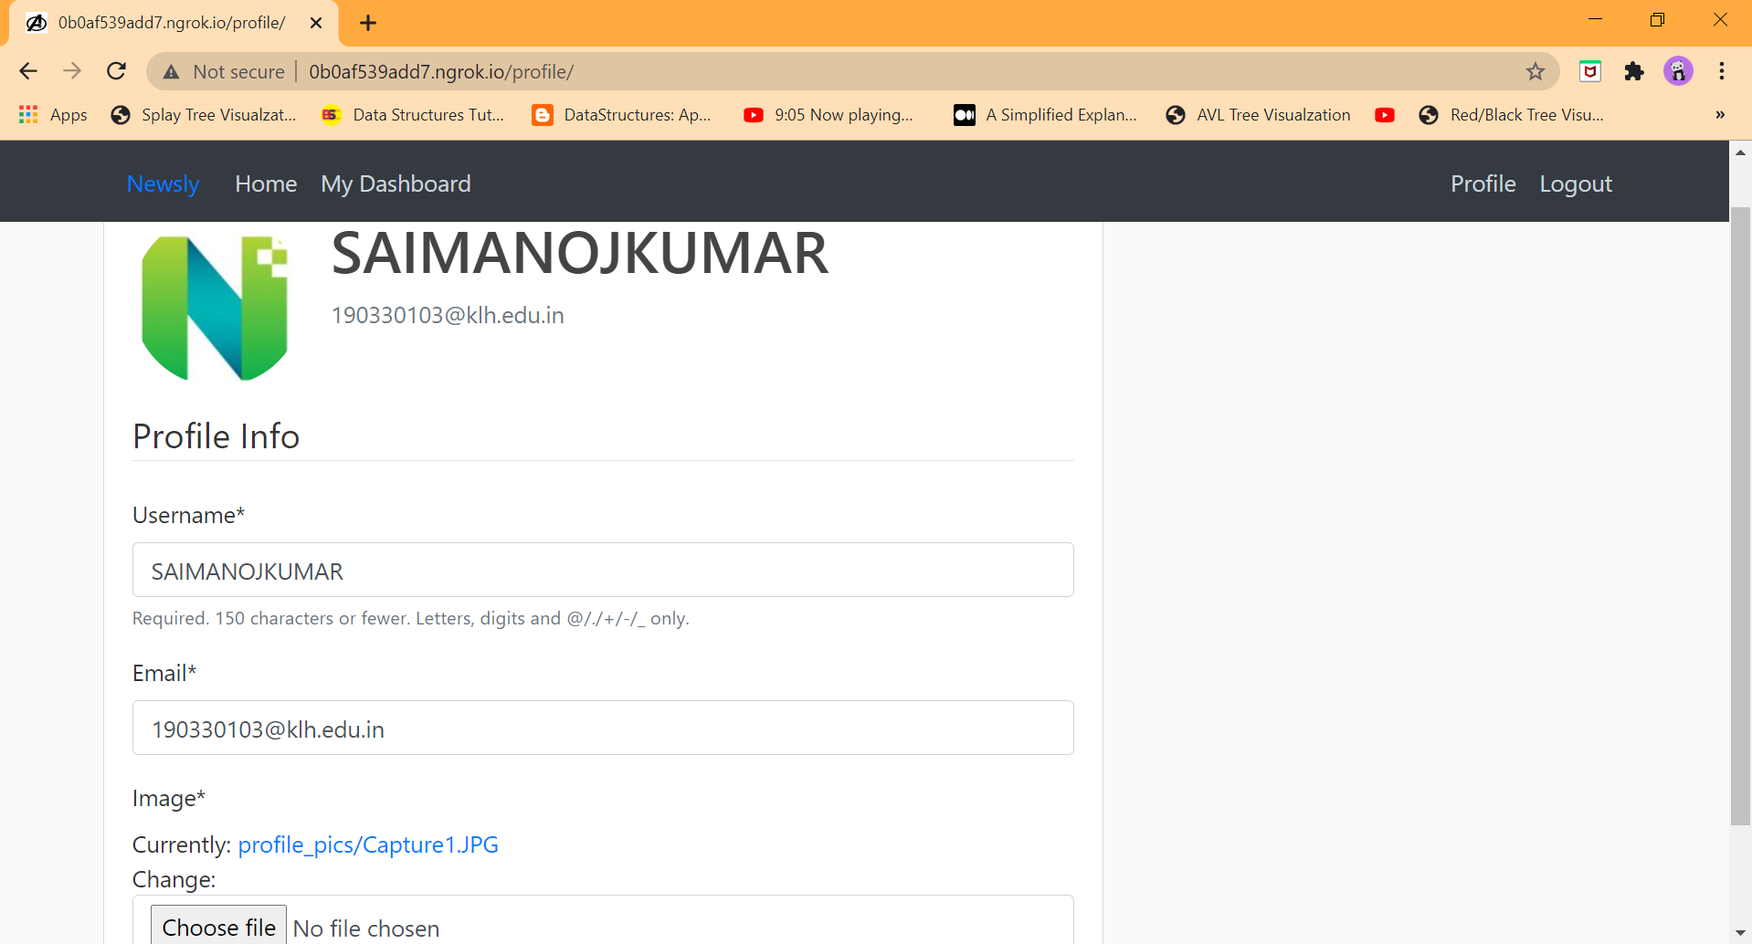

Slide 18
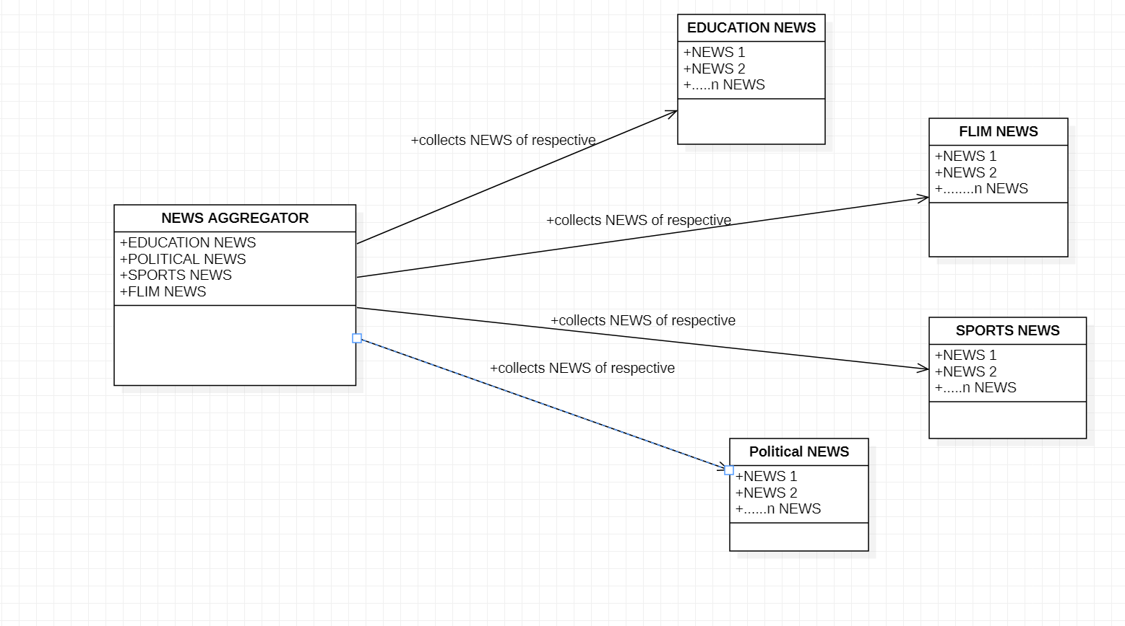
Uml Diagram

Slide 19
SYSTEM REQUIREMENTS
1.OPERATING SYSTEM : WINDOWS 7 OR ABOVE
2.DATABASE : MYSQL
3.LANGUAGE : PYTHON USING DJANGO,HTML,CSS
4.SOFTWARES : VISUAL STUDIO CODE & PYCHARM

Slide 20
HARDWARE REQUIREMENTS
1.PROCESSOR : INTEL I3 CORE MORE(MINIMUM)
2.PROCESSOR SPEED : 2.5 GHZ
3.HARD DISK : 500GB OR 1TB(RECOMMENDED)
4.RAM : 2GB

Slide 21
CONCLUSION
TO MAKE A USER FRIENDLY AGGREGATOR WITH THE LATEST CONTENT OR INFORMATION

Slide 22
THANK YOU ...

